Slide 1
4th Year IoT Project Aquarium Monitoring System: HCFF
Julien Rose, Achille Bayart, Nicolas Rigaudy

Slide 2
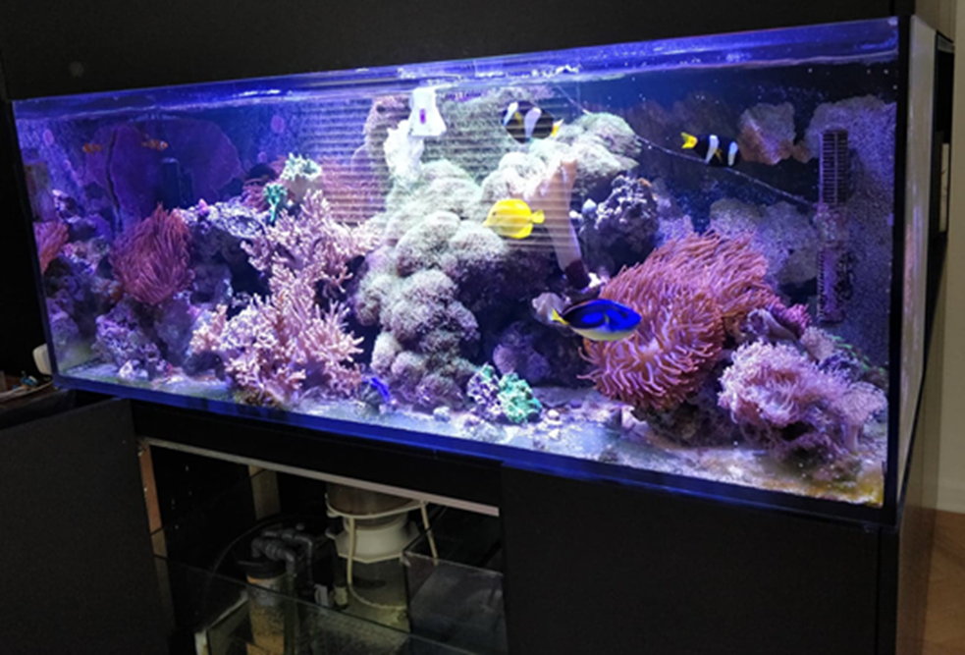
Introduction and context
Aim of the project
User: professionals or individuals
Camera
Sensors
Health monitoring
Test subject: seawater aquarium with 6 fish species

Slide 3
Introduction and context
Water level
User
Norms
Fish
Aquarium or Tank
Camera
APP
Energy
Lights
Temperature
 | Fonctions de services principales et de contraintes de l’aquarium ou bassin
FP1 | Check the visual information of the fish health.
FP2 | Show the information of the aquarium to the user.
FC1 | Monitor the water level.
FC2 | Respect the aquatic tank and user data norms.
FC5 | Use the available energy
FC3 | Automatically adjust the water temperature around a reference value
FC4 | Automatically adjust the lighting in function of the outside brightness

Slide 4
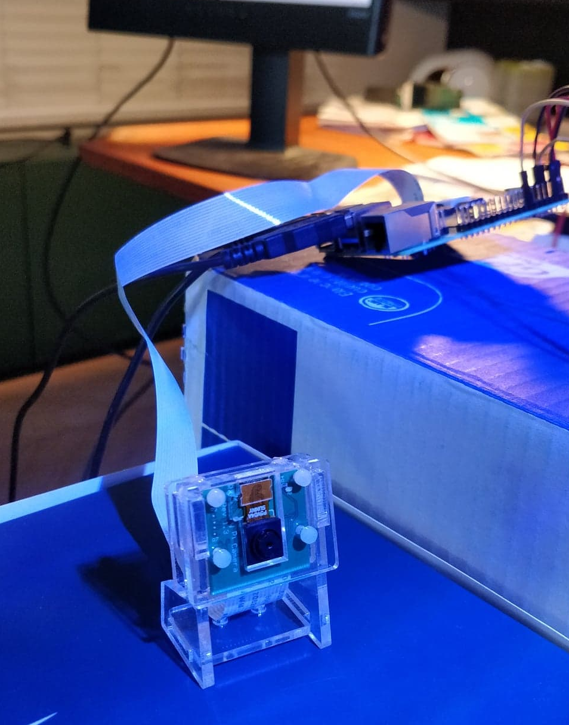
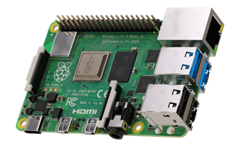
Completed work - Hardware
Raspberry Pi
Raspberry Pi 4 model B
Camera module B01

Slide 5
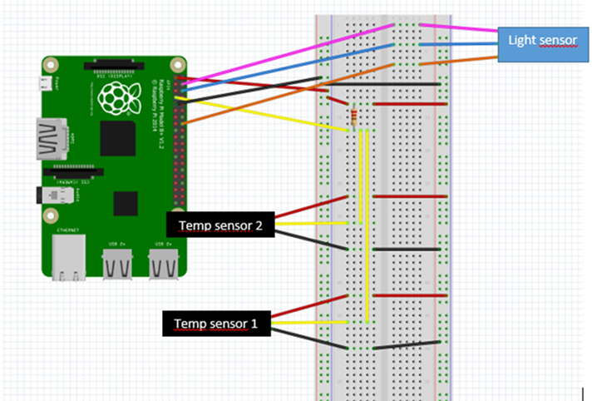
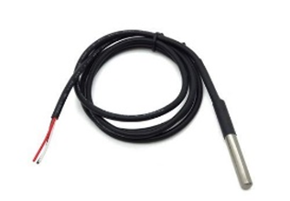
Completed work - Hardware
Temperature
DS18B20 sensor
Prototype board wiring diagram (made on Fritzing)

Slide 6
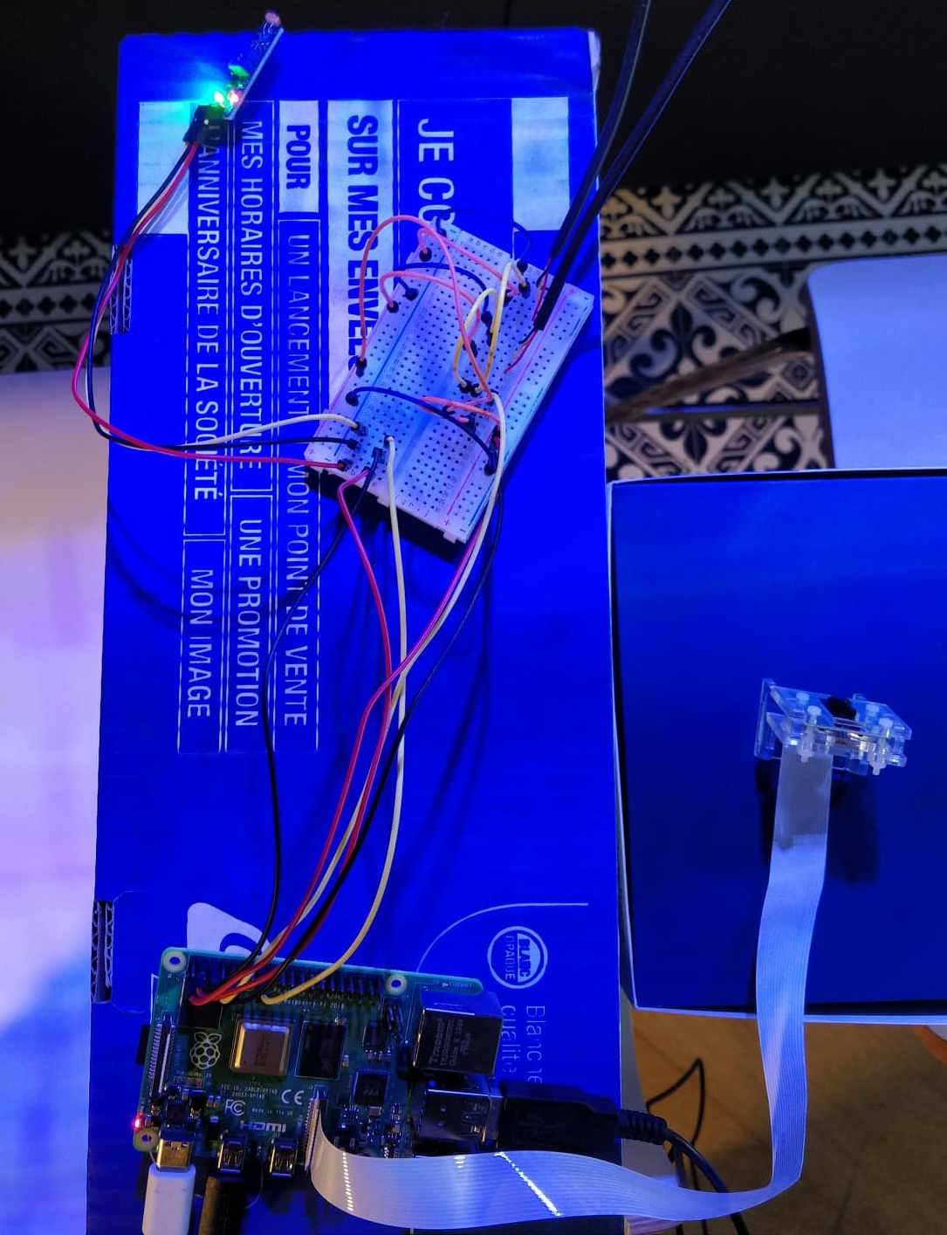
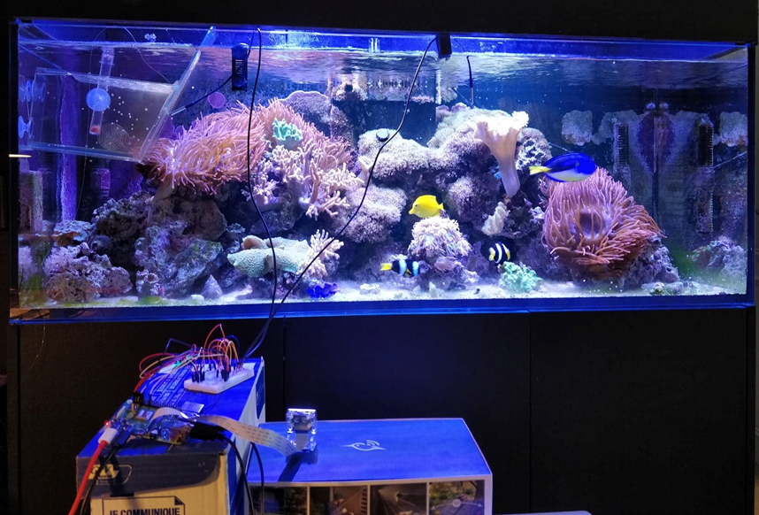
Completed work - Hardware
Temperature
Full testing setup of the system

Slide 7
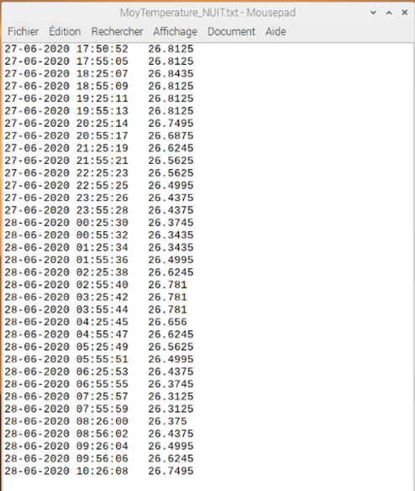
Completed work - Hardware
Temperature
Aquarium temperature during a night

Slide 8
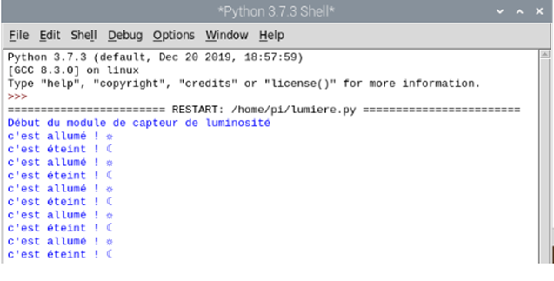
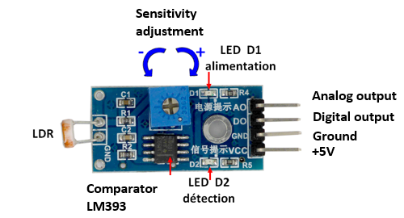
Completed work - Hardware
Brightness
Light sensor module
Results of the brightness sensor Python code

Slide 9
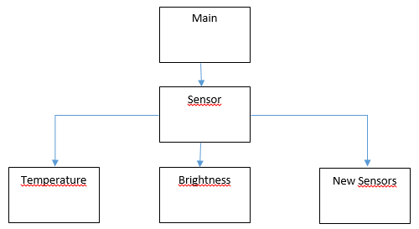
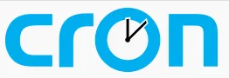
Completed work - Hardware
Class hierarchy & Automatic scheduling of data collection
Cron permits to run the program every minute
Planned class architecture for sensors

Slide 10
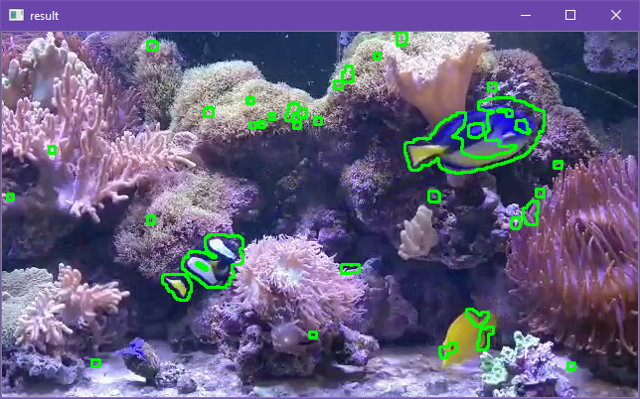
Completed work - Image Recognition - OpenCV
Contours
OpenCv result of contours

Slide 11
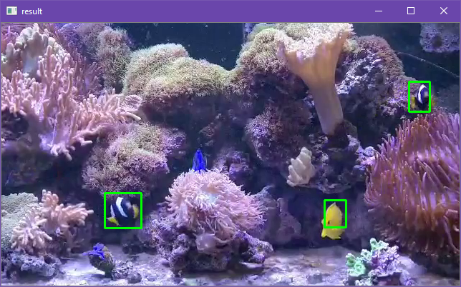
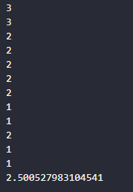
Completed work - Image Recognition
Boundary Boxes
Counting the number of fish
OpenCv result of boundary boxes

Slide 12
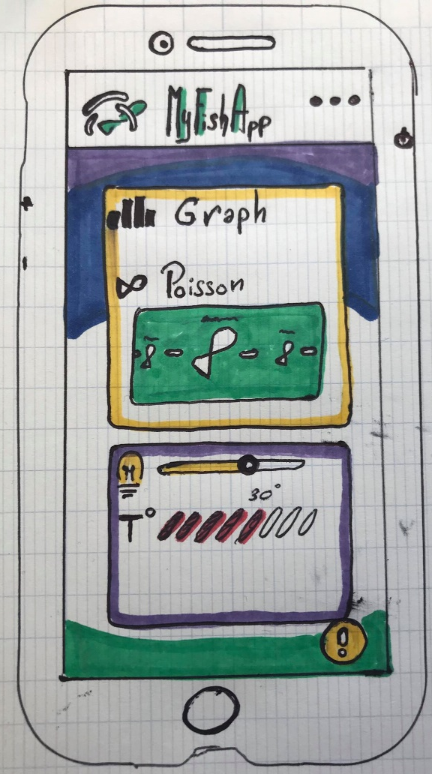
Completed work - Android App
Initial concept:
Meets the needs:
FP1 : Check the visual information of health of the fish.
FP2 : Show the information of the aquarium for the viewer.
FC1: Monitor the level of water
Should be:
Entertaining
Intuitive
A smart interface

Slide 13
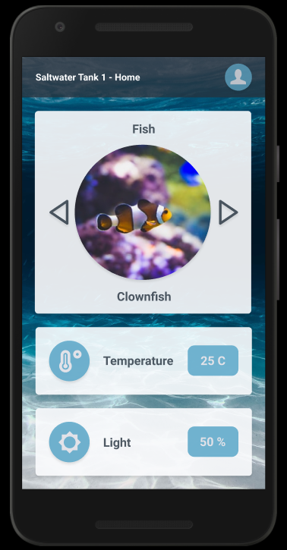
Completed work - Android App
Figma :
Prototype our ideas.
Simplify the steps between drawing and code.
Get sample code to understand how to create interface.
Entertainment section
Main information of the Aquarium

Slide 14
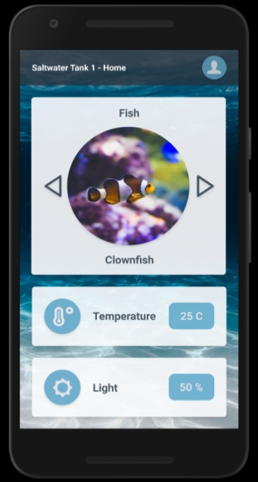
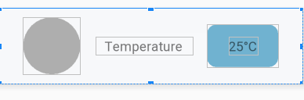
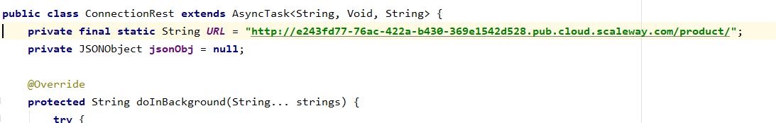
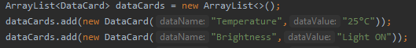
Completed work - Android App
Android Studio
CARD VIEW
CONNECTIVITY

Slide 15
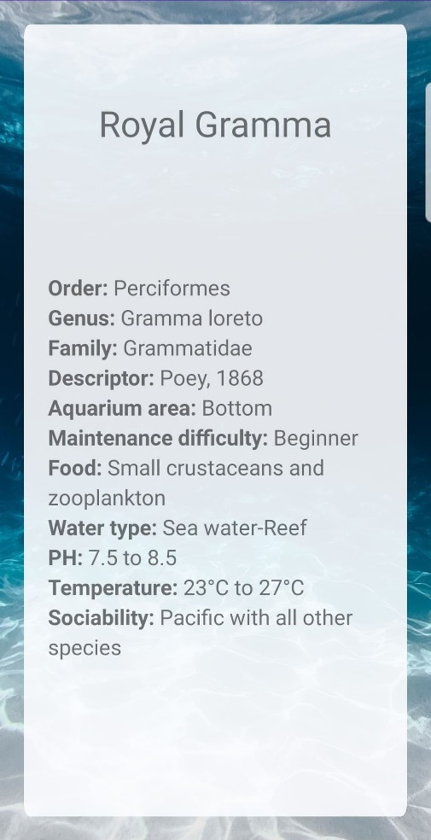
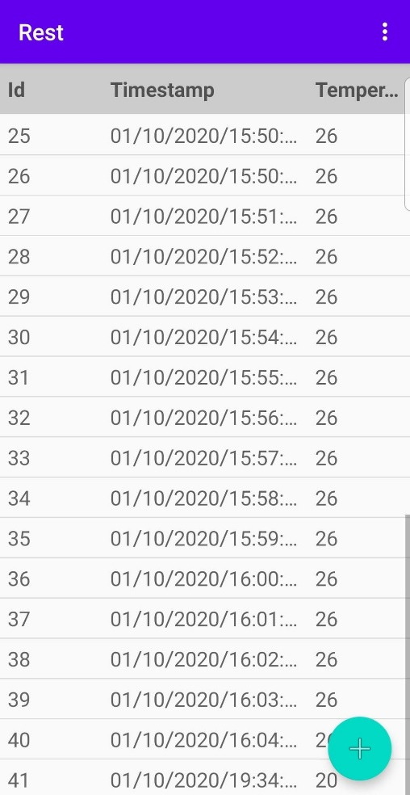
Completed work - Android App

Slide 16
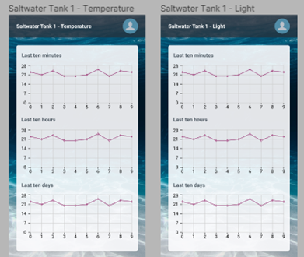
Project perspective
Planned additions
New sensors
Antomatic food dispenser
New options on the App
HCFF system for profesionals
Temperature and brightness graphs

Slide 17

Project perspective
Challenges
Connecting all the elements of the project together
Knowing our limits in term of project scope
Coronavirus and working apart from each other

Slide 18

Thanks for listening

